Slide 1

Robot Operating System (ROS) on RT-Thread
Han Wu
ROS Intro and Demo
RT-Thread (rosserial and micro_ros)
Known issues

Slide 2
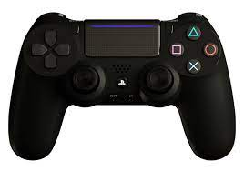
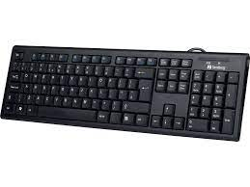
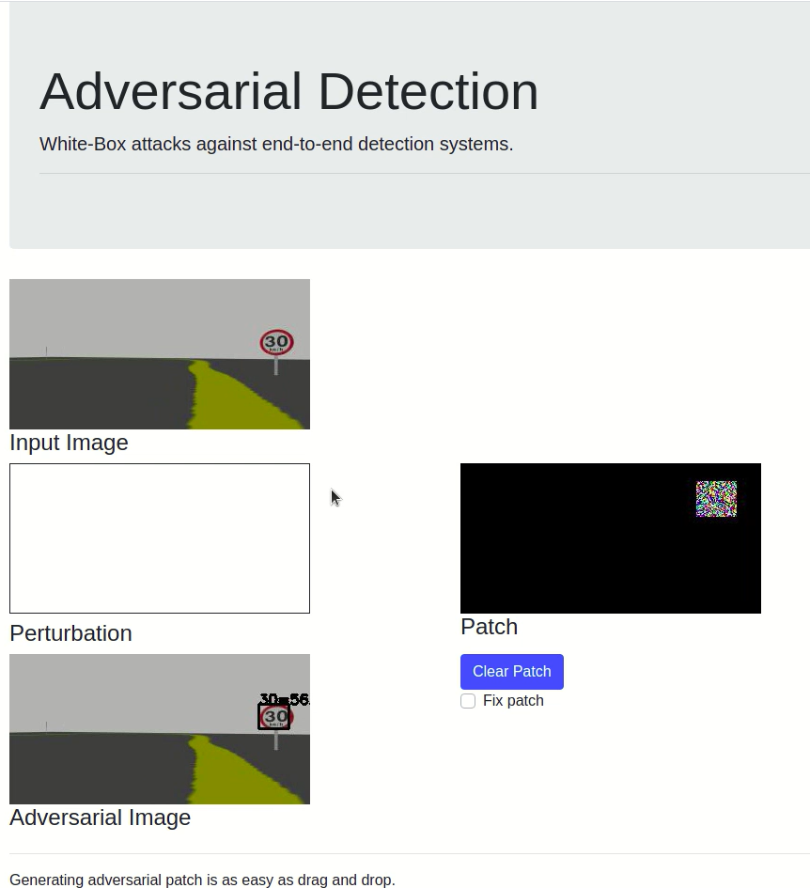
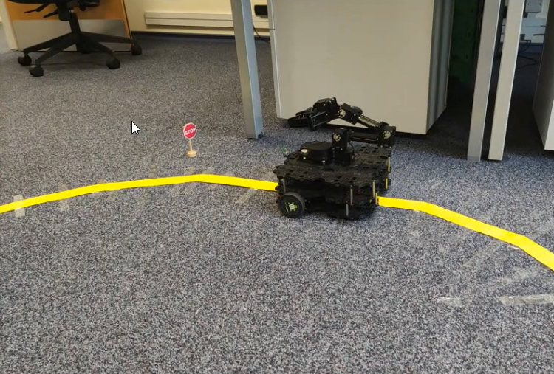
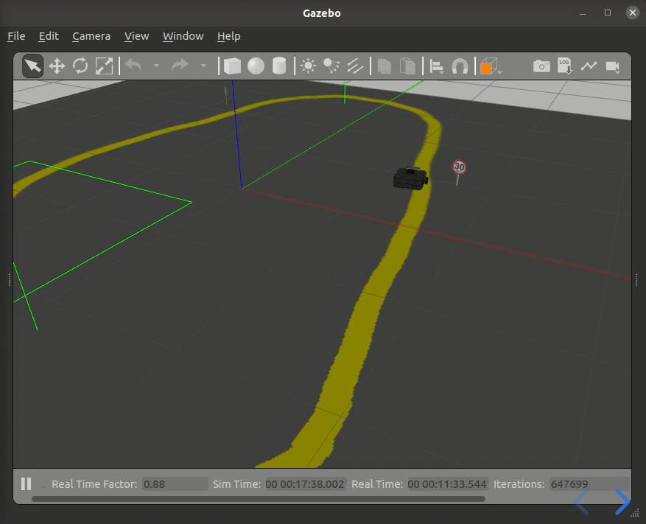
Adversarial Detection
Keyboard Controller
(Node 1)
Subscribe to the topic
/cmd_vel
/image
Publish the topic
Object Detection
ROS Gazebo Simulator
(Node 3)
(Node 2)
The same code works for both simulated robots and real robots.

Slide 3




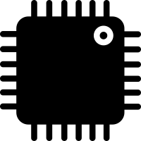
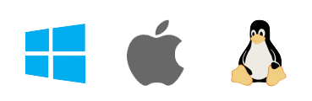
Difference between rosserial and micro_ros
rosserial
micro_ros
rosserial
rosserial package
rosserial node
micro_ros
micro_ros package
micro_ros agent

Slide 4
Difference between rosserial and micro_ros
ROS decouples software from hardware.
rosserial
micro_ros
RT-Thread provides support for real-time applications.

